Slide 1
X Education – Lead Scoring Case Study
Presented by:
Kanchetti Gnyanesh

Slide 2
Agenda:
The typical lead to successful sale conversion rate at X education is around 30%.
Although X Education gets a lot of leads, its lead-to-sale conversion rate is very poor.
To make this process more efficient, the company wishes to identify the most potential leads, also known as ‘Hot Leads’.
The CEO, in particular, has given a ballpark estimate of the target lead conversion rate as being around 80%.

Slide 3
Objectives:
Our goal is to increase the conversion rate to around 80%.
Develop a logistic regression model to assign a lead score between 0 and 100 to each lead, which the organization may use to target potential leads.
There are certain more issues posed by the company that your model should be able to handle if the company's requirements alter in the future, so you will need to address these as well.

Slide 4
Background:
X Education , An education company named sells online courses to industry professionals
Many interested professionals land on their website
The company markets its courses on several websites like Google. Once these people land on the website, they might browse the courses or fill up a form for the course or watch some videos

Slide 5
Background:
When these people fill up a form providing their email address or phone number, they are classified to be a lead
Once these leads are acquired, employees from the sales team start making calls, writing emails, etc. Through this process, some of the leads get converted while most do not
The typical lead conversion rate at X education is around 30%

Slide 6
Lead – Conversion Process
The company markets its courses on several websites, search engines, and even social media sometimes.
Once these people land on the website, they might browse the courses, fill out a form for the course, or watch some videos.
When these people fill out a form with their email address or phone number, they are classified as leads.
Once these leads are acquired, employees from the sales team start making calls, writing emails, etc. Through this process, some of the leads get converted into successful sales

Slide 7
Data Sources:
You were given a leads dataset from the past that contained approximately 9000 data points. This dataset consists of various attributes such as Lead Source, Total Time Spent on the Website, Total Visits, Last Activity, etc., which may or may not be useful in ultimately deciding whether a lead will be converted or not. The target variable, in this case, is the column ‘Converted’, which tells whether a past lead was converted or not, where 1 means it was converted and 0 means it wasn’t converted.

Slide 8
Implementation:
Data Gathering
Loading & Observing the past data provided by the Company
Data Cleaning
Duplicate removal, null value treatment, unnecessary column elimination, etc.
Performing EDA
Univariate, Bivariate, and Heatmap for numerical and categorical columns
Data Preparation
Outlier Treatment, Feature-Standardization
Model Building
Performing pre-requisites for RFE and Logistic Regression

Slide 9
Implementation:
Feature Selection
Selection of top 25 features using RFE
Model Building
Model building using RFE for selected columns
Model Improvement
Reduction of columns and Model re-building
Final Model
Final Model Analysis and performance on Test Data

Slide 10
Visual Analysis

Slide 11
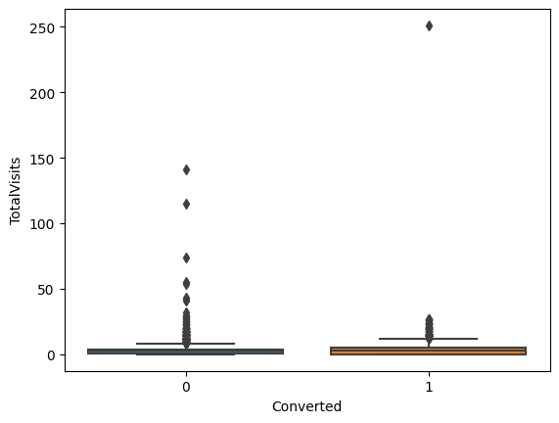
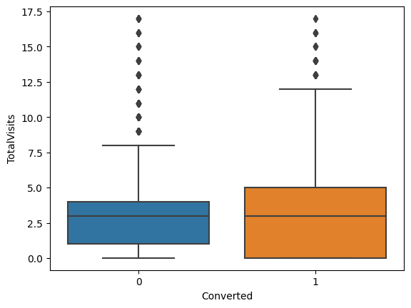
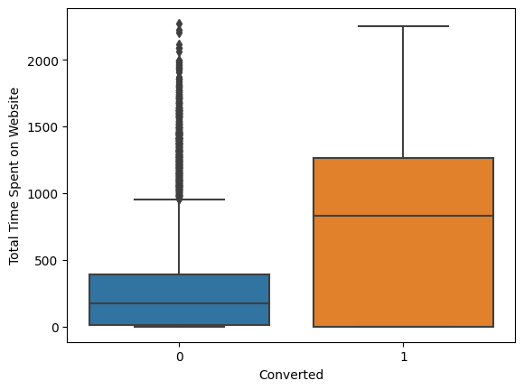
EDA plots depicting variation in numerical columns for those who Converted and those who didn't.

Slide 12
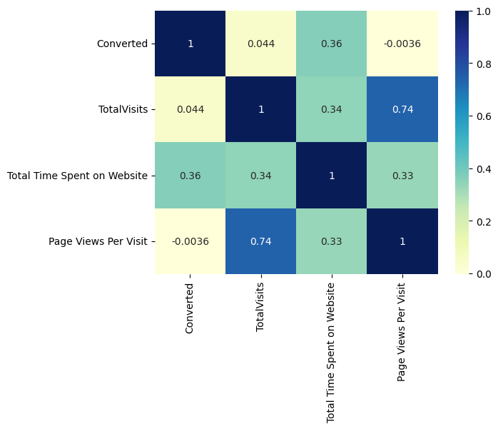
EDA plots depicting correlation (Heat Map) of all selected numerical columns.

Slide 13
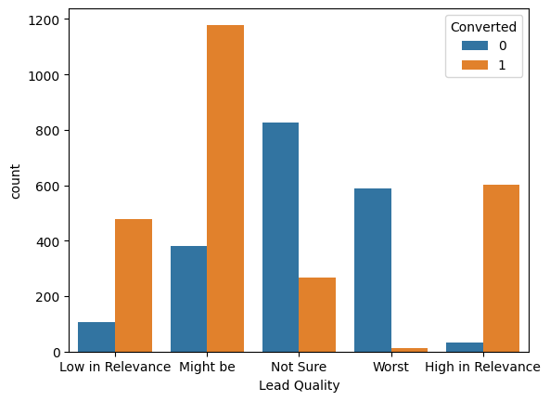
EDA plots depicting variation in categorical column (Lead Auality) for those who Converted and those who didn't.

Slide 14
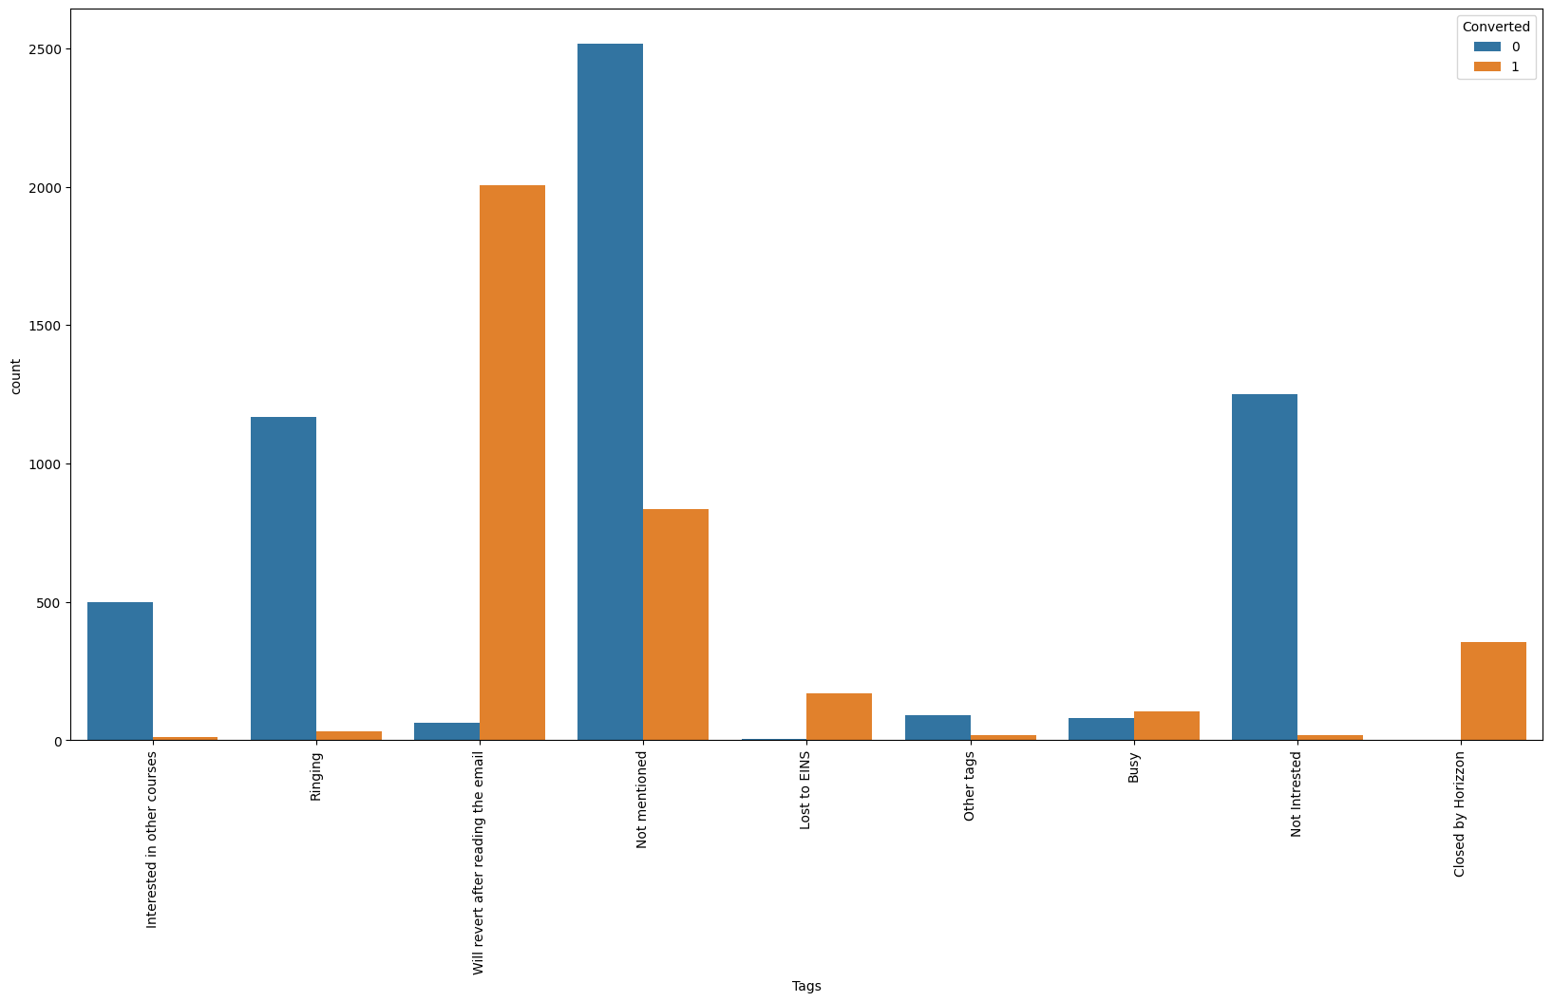
EDA plots depicting variation in categorical column (Tags) for those who Converted and those who didn't.

Slide 15
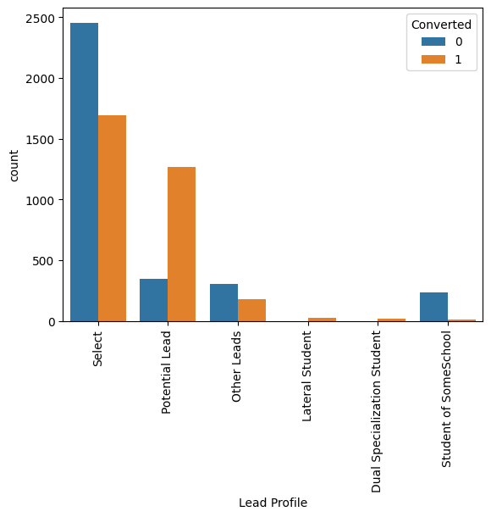
EDA plots depicting variation in categorical column (Lead Profile) for those who Converted and those who didn't.

Slide 16
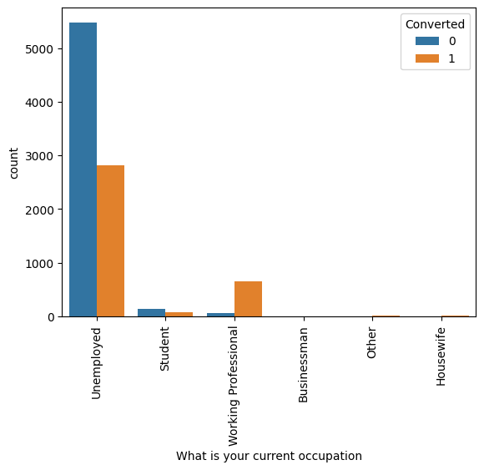
EDA plots depicting variation in categorical column (What is your current occupation) for those who Converted and those who didn't.

Slide 17
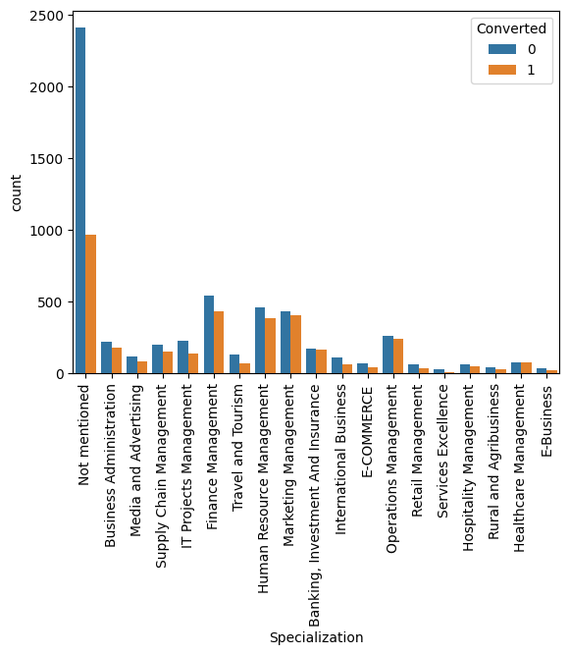
EDA plots depicting variation in categorical column (Specialization) for those who Converted and those who didn't.

Slide 18
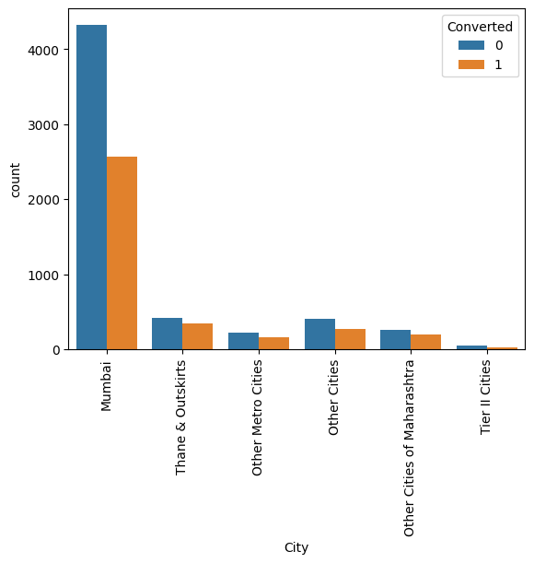
EDA plots depicting variation in categorical column (City) for those who Converted and those who didn't.

Slide 19
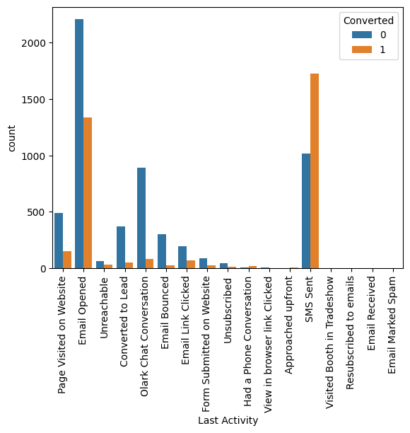
EDA plots depicting variation in categorical column (Last Activity) for those who Converted and those who didn't.

Slide 20
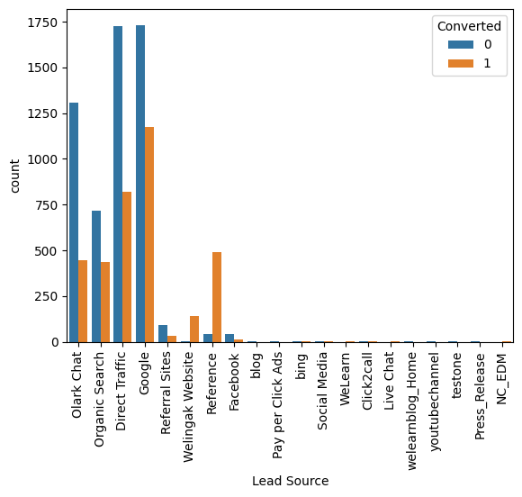
EDA plots depicting variation in categorical column (Lead Source) for those who Converted and those who didn't.

Slide 21
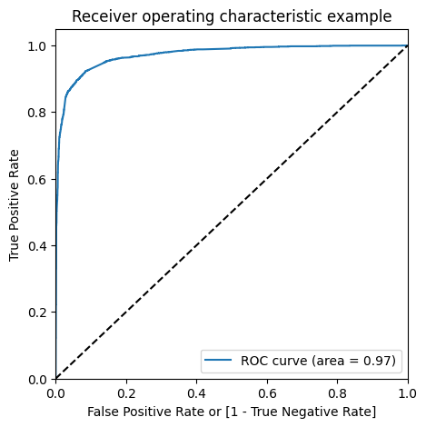
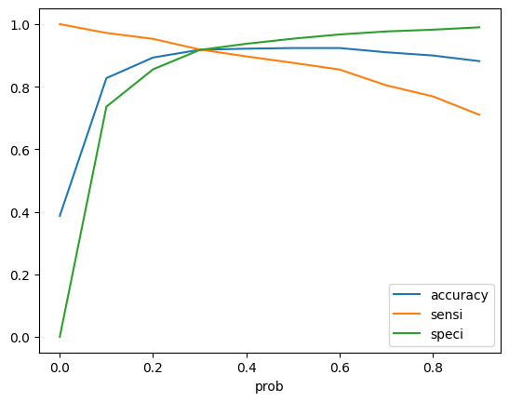
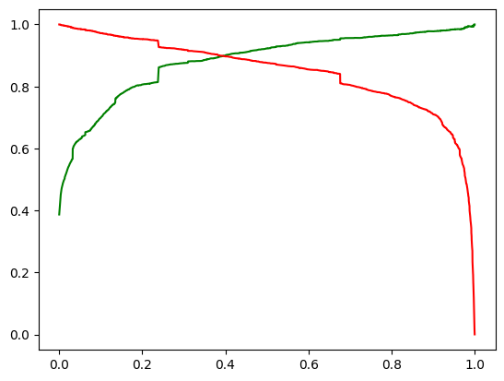
Linear Regression Final Model Parameters Area under ROC = 0.97 Intermediate cut-off = 0.3 Final cut-off = 0.35

Slide 22
Model Performance:
Overall accuracy on Test set: 92.76%
Sensitivity of our logistic regression model: 91.29%
Specificity of our logistic regression model: 93.66%

Slide 23
Business Insights Derived from our Model
Top variables in model, that should be focused are:
Tags_Closed by Horizzon
Last Activity_Olark Chat Conversation
Tags_Lost to EINS
Tags_Interested in other courses (Negative impact)
Tags_Not Interested (Negative impact)
Tags_Ringing (Negative impact)

Slide 24
Conclusion:
Our Logistic Regression Model is decent and accurate enough, when compared to the model derived using PCA, with 92.76% Accuracy on Test Set, 91.29% Sensitivity and 93.66% Specificity. We can vary these parameters by varying the cut-off value and thus predict Hot leads based on scenarios like availability of extra resources and vice-versa.

